Slide 1

AI assistants
Saavedra Erwin
Dudic Mateja
Krylova Alena
Maringer Kelvin

Slide 2
Introduction
Dataset about daily AI assistant usage
Focuses on when, how, and for what purposes users interact with AI
Dataset Structure: 300 rows and 8 columns

Slide 3
Packages used
Pandas
NumPy
Seaborn
Matplotlib

Slide 4
Data Overview
Categorical features:
device
usage_category
assistant_model
Numerical features:
prompt_length
session_length_minutes
tokens_used
satisfaction_rating
Additional feature: timestamp
The dataset combines categorical and numerical features, allowing analysis of usage patterns and session characteristics.

Slide 5
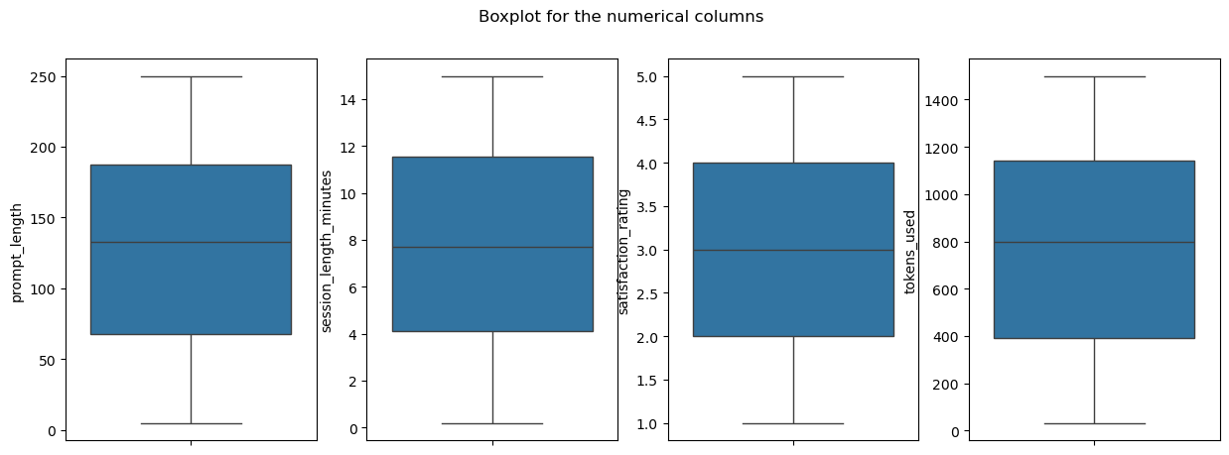
Data Quality check
The dataset was checked for missing values and outliers
No missing values were detected in any of the features
Boxplots showed no significant outliers in numerical values.
Frequency analysis of categorical features revealed no unusual or rare values.

Slide 6
Data Preprocessing
Tasks:
Handle missing values and outliers appropriately.
Create a new column timeOfDay, which bins the timestamp into morning, afternoon, evening, and night.
Create a new column year, which is derived from the timestamp column.
Convert data types where needed (e.g., categorical columns).

Slide 7

Missing values and outliers
There were no outliers neither missing data , everything was surprisal clean, so I had to do nothing, For this task.

Slide 8
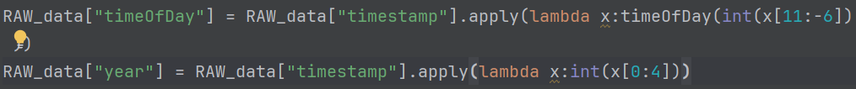
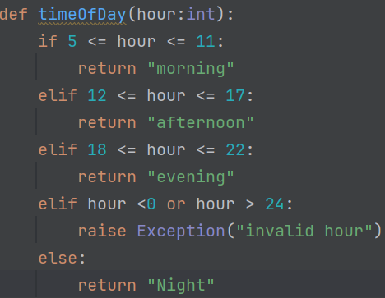
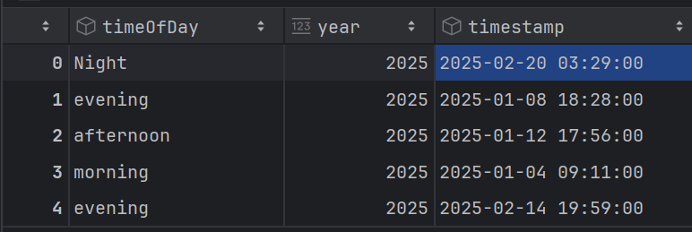
Create column timeOfDay And column Year

Slide 9
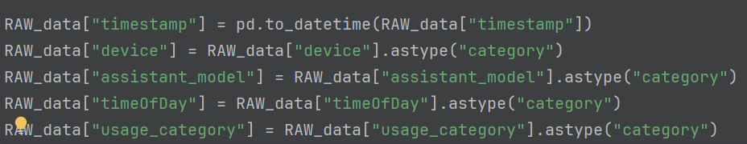
Convert to the correct datatypes. Code

Slide 10
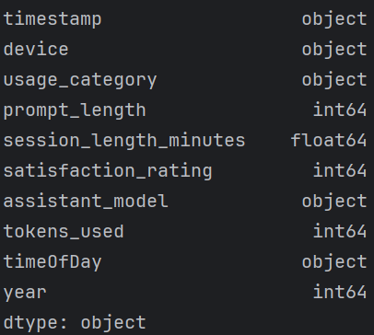
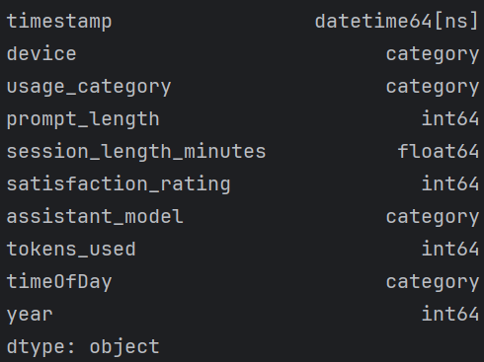
Convert to the correct datatypes. Visual
Before
After

Slide 11
Data Analysis #1
How many different AI assistants are in the dataset? Show counts and percentages.
What is the average session length per assistant? Are there noticeable differences?
Are specific assistants used more often for certain tasks (e.g., education)?
Which type of tasks has the longest average prompt size and use time?
Is there a pattern between the task type and the time of day it was used?
Have some AI assistants become more popular over time?

Slide 12
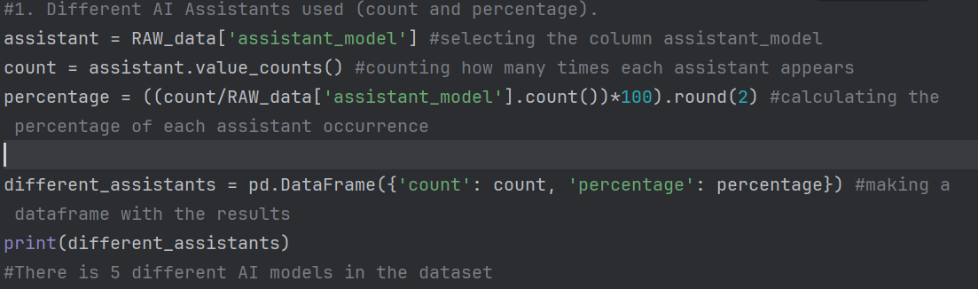
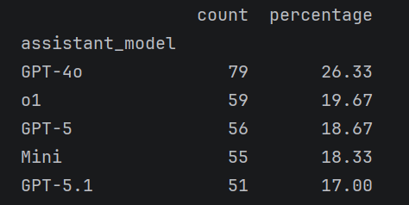
How many different AI assistants are in the dataset?
There is 5 different AI assistants
GPT-4 occurs the most in the dataset

Slide 13
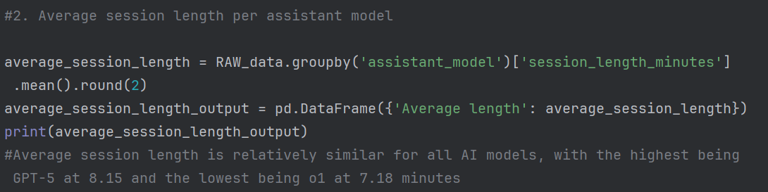
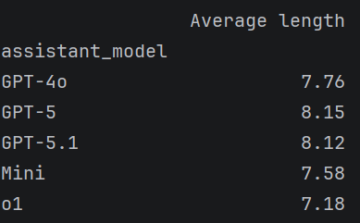
What is the average session length per assistant? Are there noticeable differences?
There is no significant differences in average session length per assistant
GPT-5 has the longest average session length at 8.15 minutes
O1 has the shortest average session length at 7.18 minutes

Slide 14
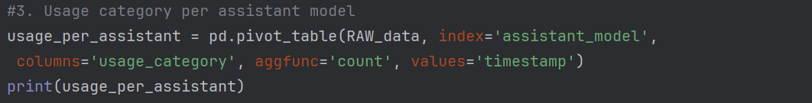
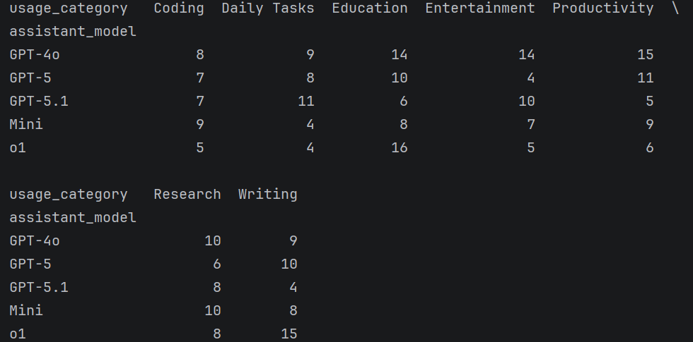
Are specific assistants used more often for certain tasks?
It is noticeable that o1 is used more for education and writing than other tasks

Slide 15
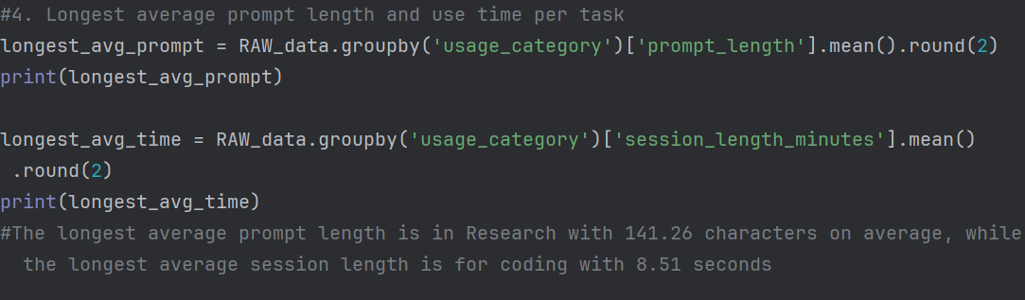
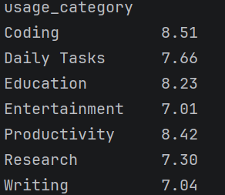
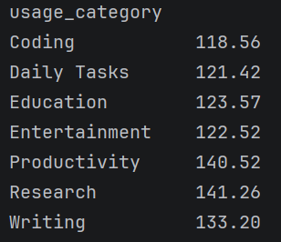
Which type of tasks has the longest average prompt size and use time?
The longest average prompt length is in Research with 141.26 characters
The longest average session length is in Coding with 8.51 minutes
Average session length
Average prompt length

Slide 16
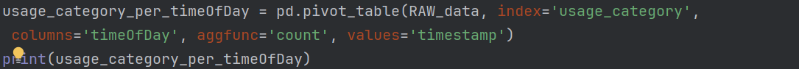
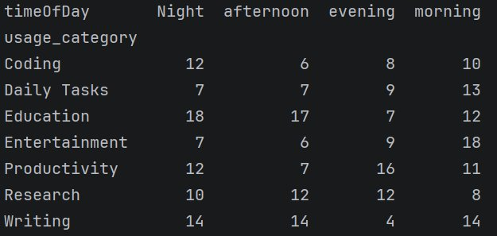
Is there a pattern between the task type and the time of day it was used?
Most categories have a specific time of day during which they are clearly less used.
Education is used the least at night
Writing is used the least during the evening

Slide 17
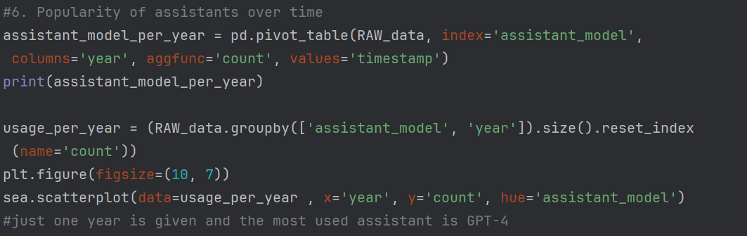
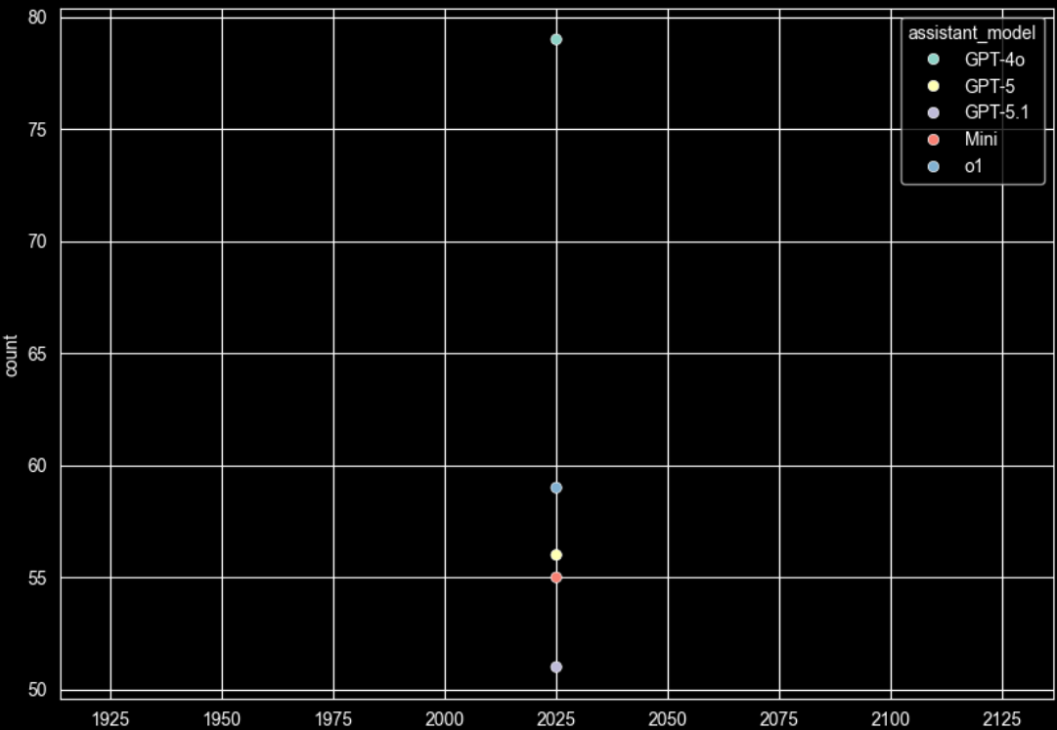
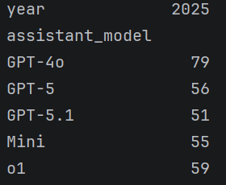
Have some AI assistants become more popular over time?
There is only one year in the dataset and GPT-4 is the most used model

Slide 18
Data Analysis #2
Visualizations
Are there any features that clearly differentiate device types?
Use pair plots to explore feature relationships, color-coded by the assistant model.
Correlation Analysis
Time-Based Analysis.

Slide 19
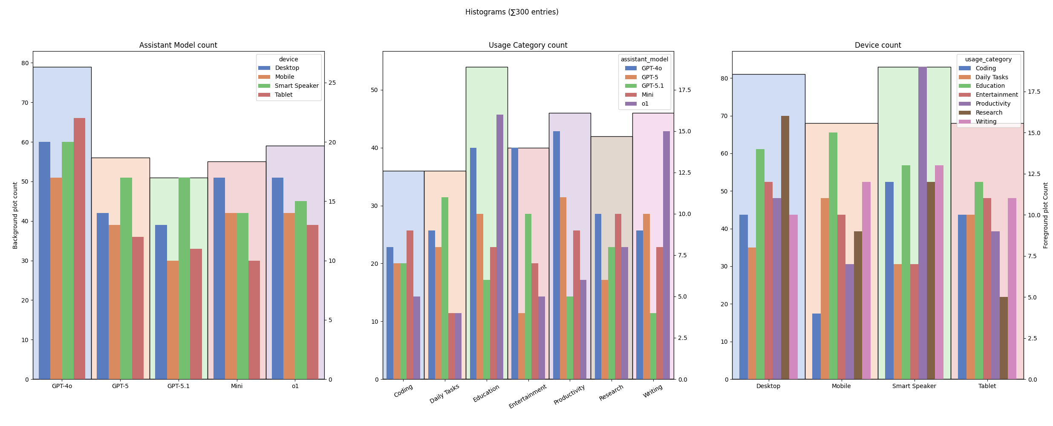
Visualization - Histograms

Slide 20
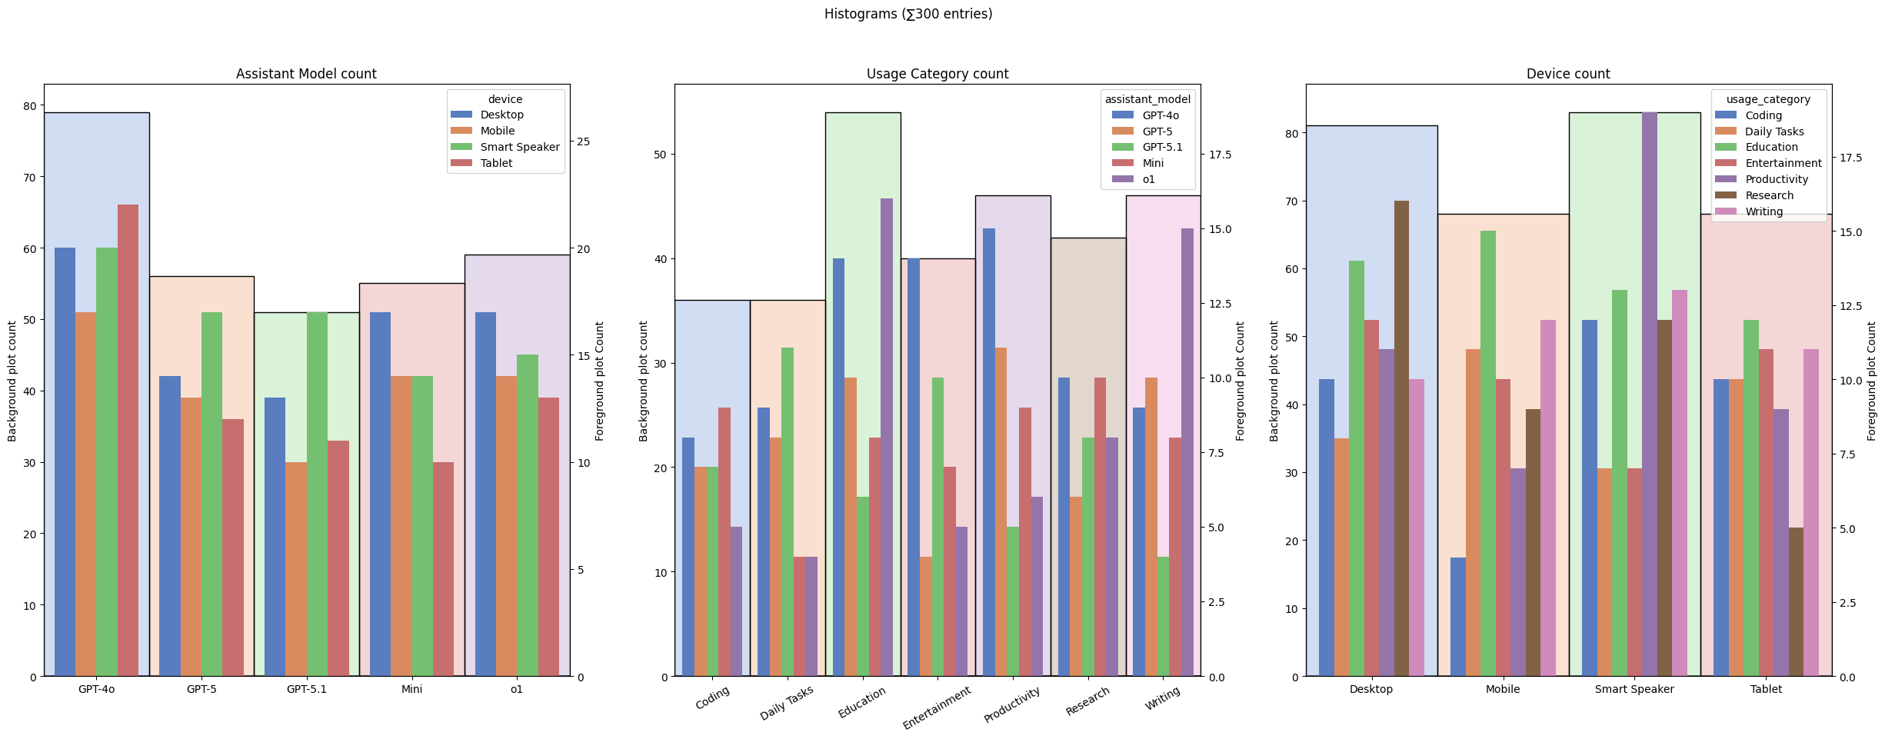
Visualization
GPT-4o is the most used model
GPT-5.1 is often used on smart speakers

Slide 21
Visualization
AI assistants are often used for Education
o1 is often used for writing, not for productivity

Slide 22
Visualization
Desktops and smart speakers are often used
Smart Speakers are mostly used for productivity
-> Smart Speakers are also used for coding

Slide 23
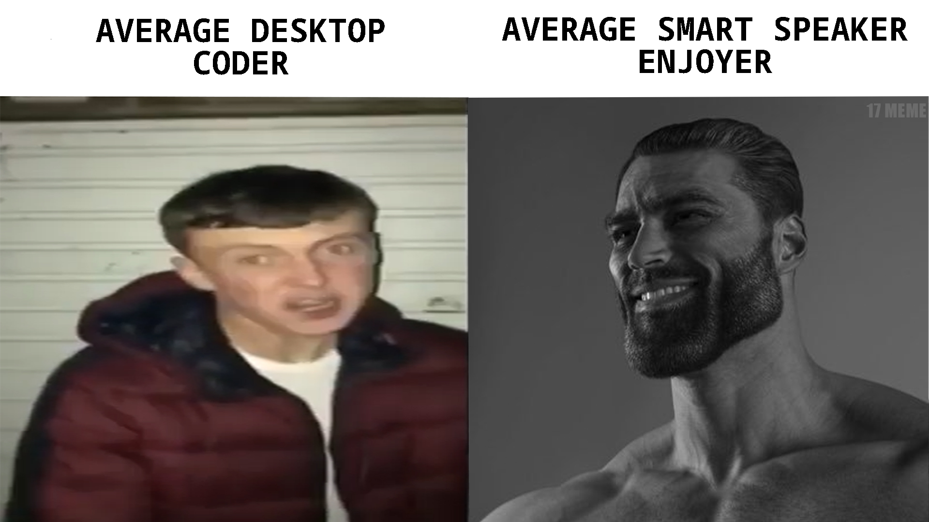
Coding on Smart Speakers

Slide 24
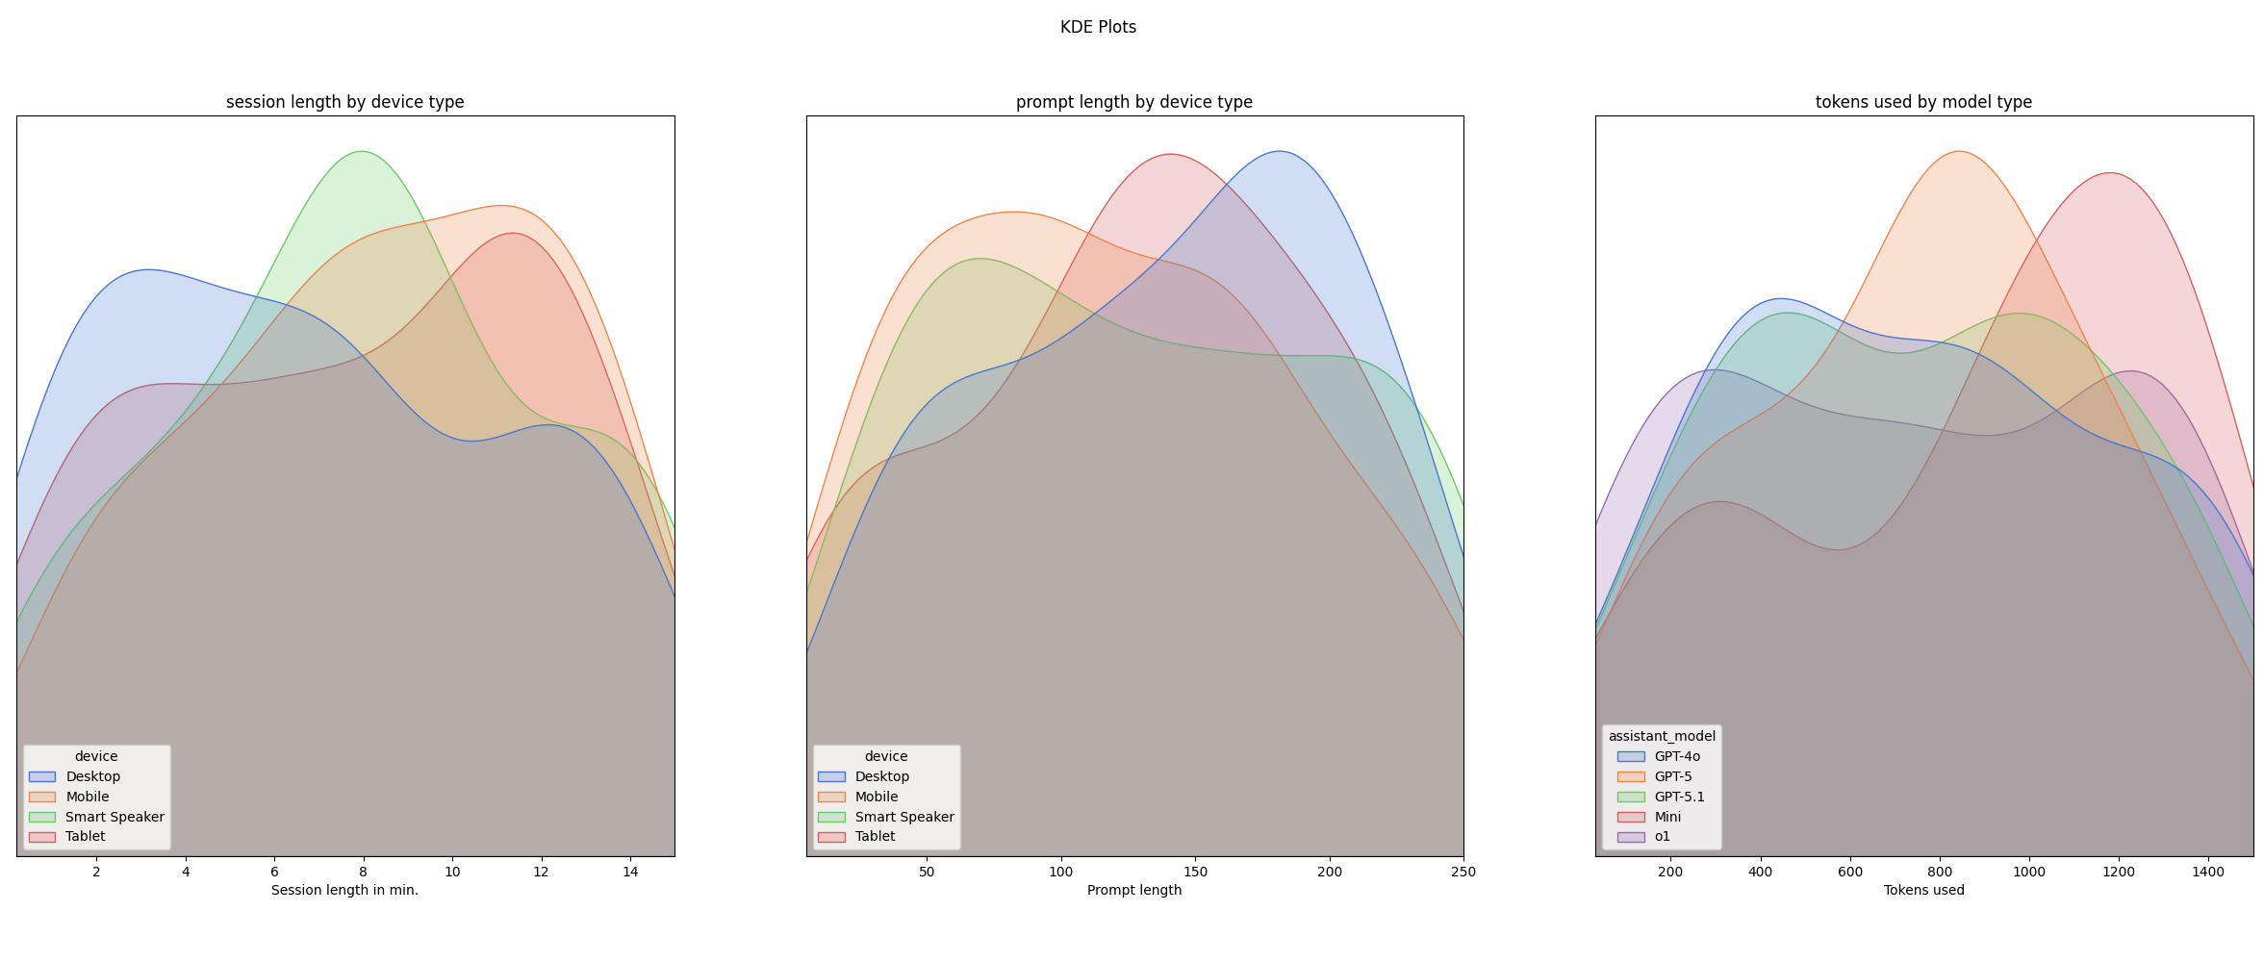
Visualization - Distribution

Slide 25
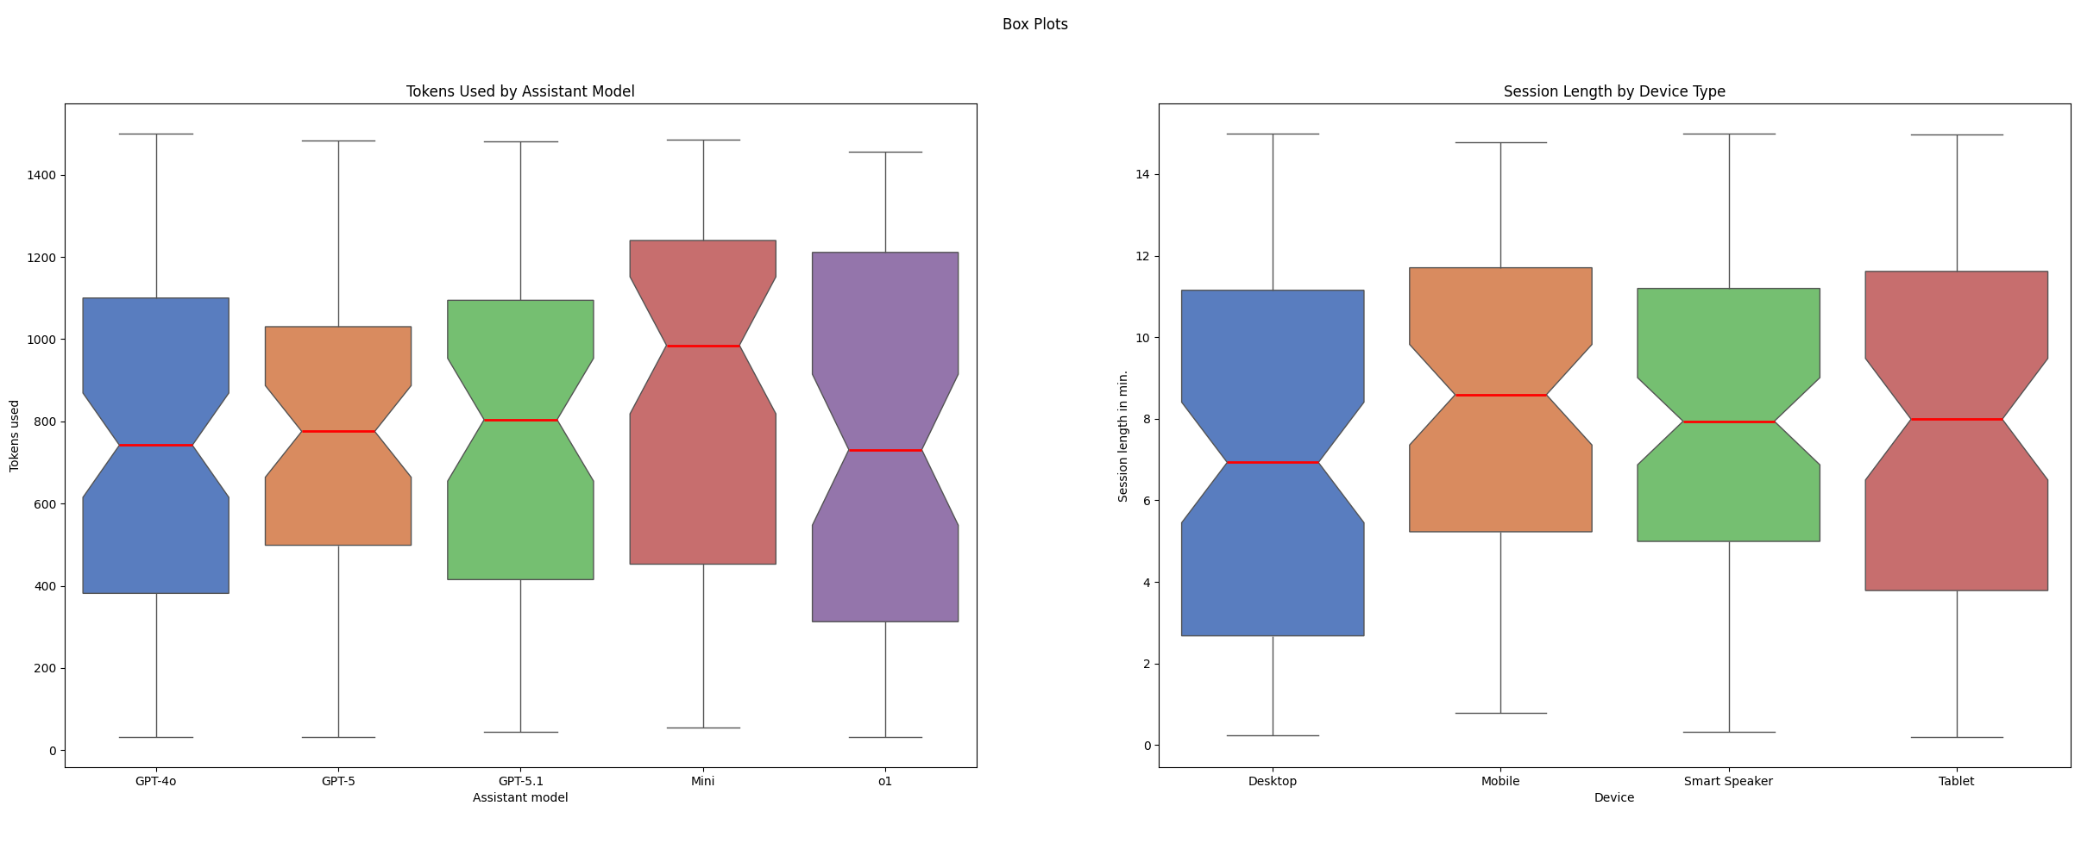
Visualization – Box Plots

Slide 26
Are there any features that clearly differentiate device types?
No.
Best features for device-type estimation:
Usage-category
Prompt-length
Session length
-> ONLY USEFULL TOGETHER
Notes:
Usage category: sometimes clear patterns emerge, for example if you code a lot on your device, then you are _most likely_ not a mobile user
Prompt-length: higher prompt length -> likely desktop
Session length: session length allways arround 8 minutes -> likely smart speaker

Slide 27
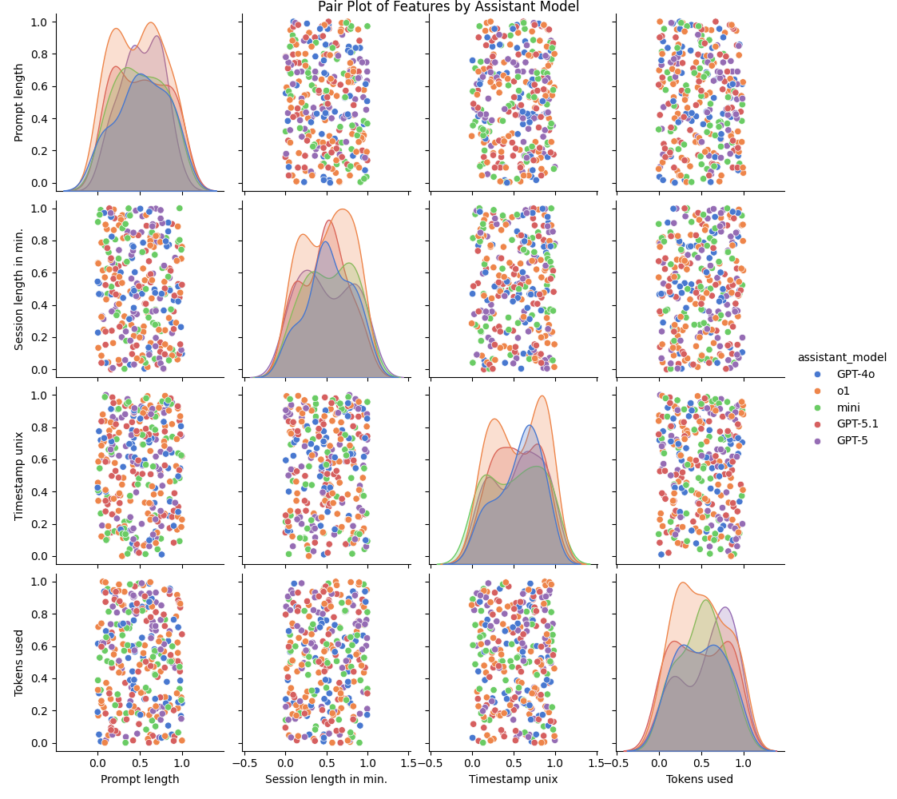
Pair Plots
…
What?

Slide 28
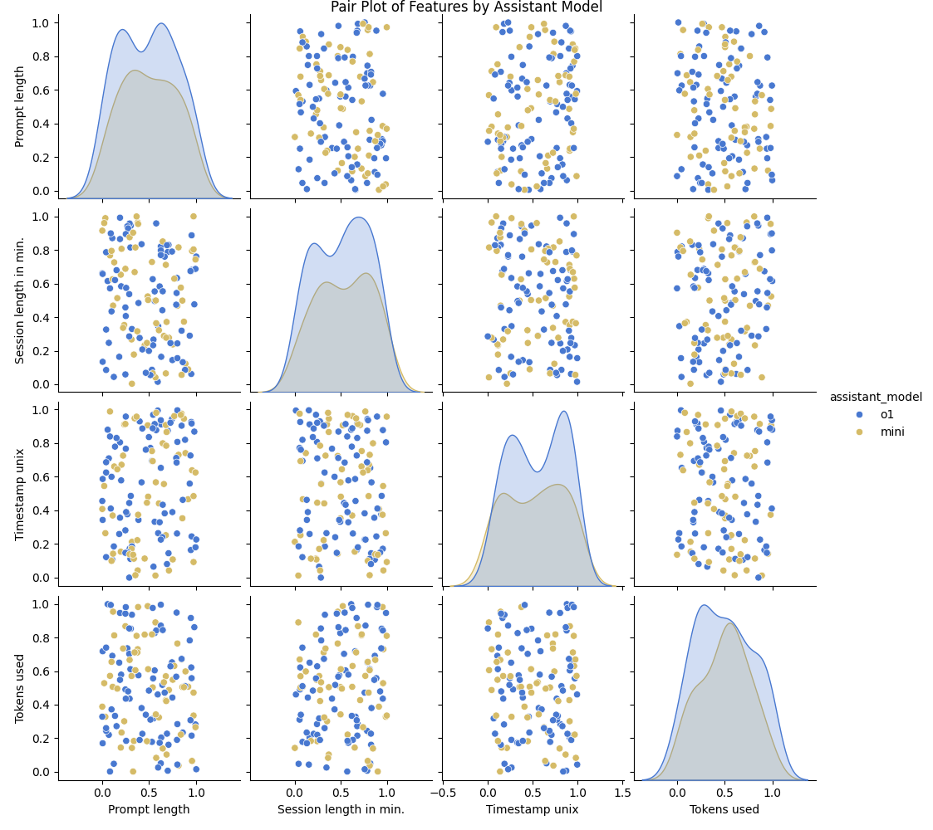
Pair Plots
…

Slide 29
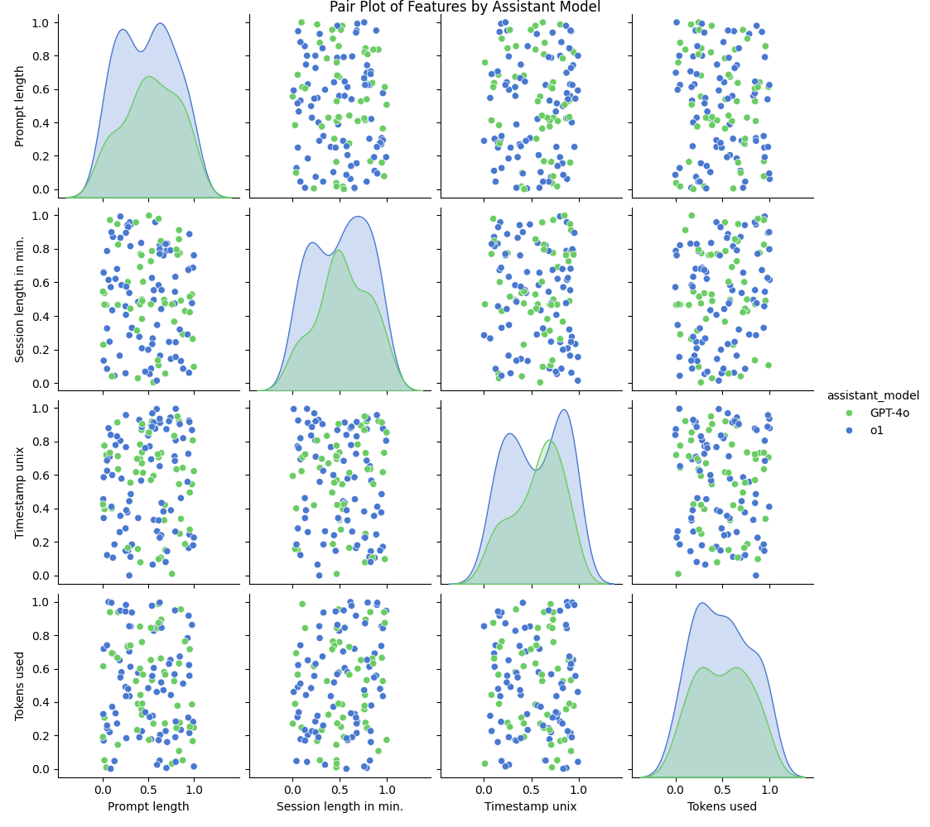
Pair Plots
….

Slide 30
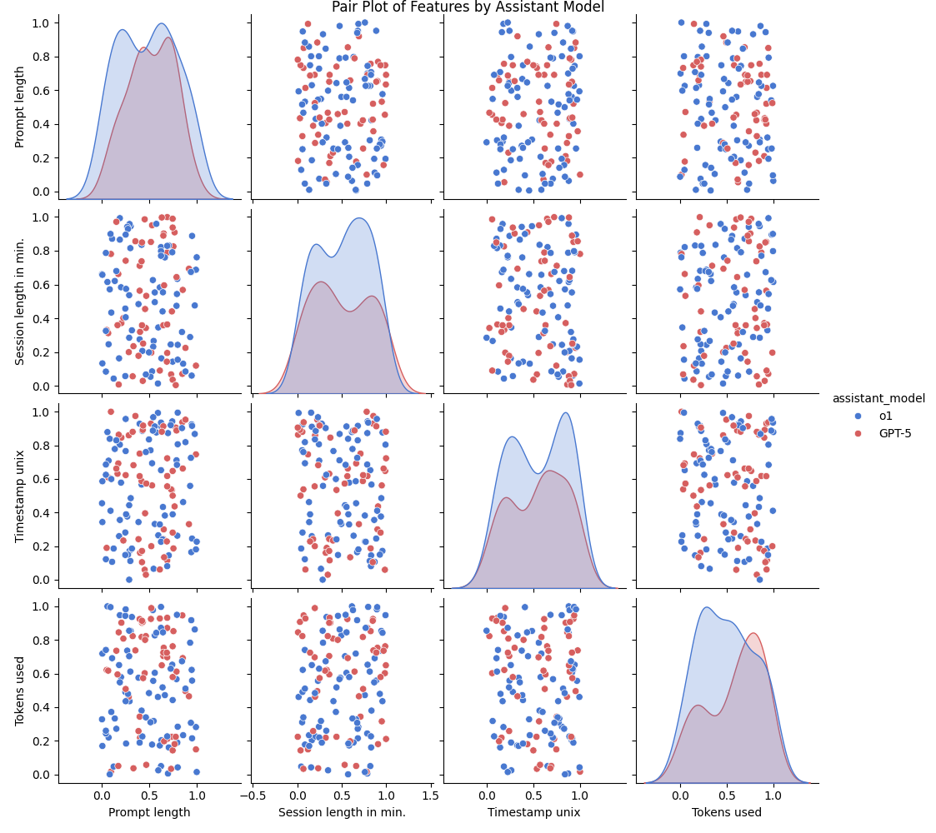
Pair Plots
…..

Slide 31
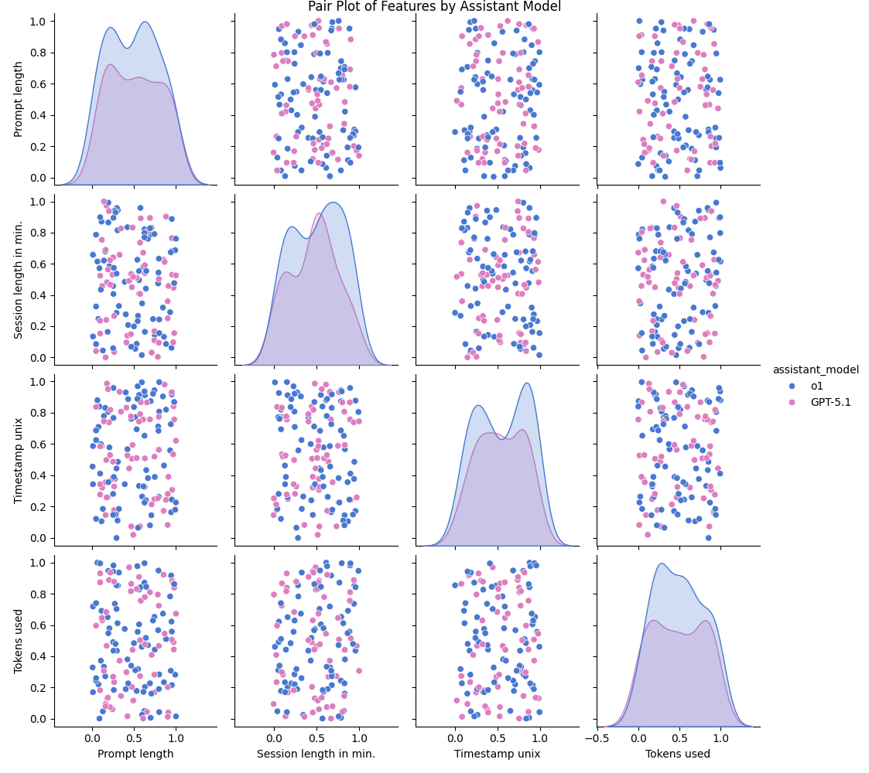
Pair Plots
……

Slide 32
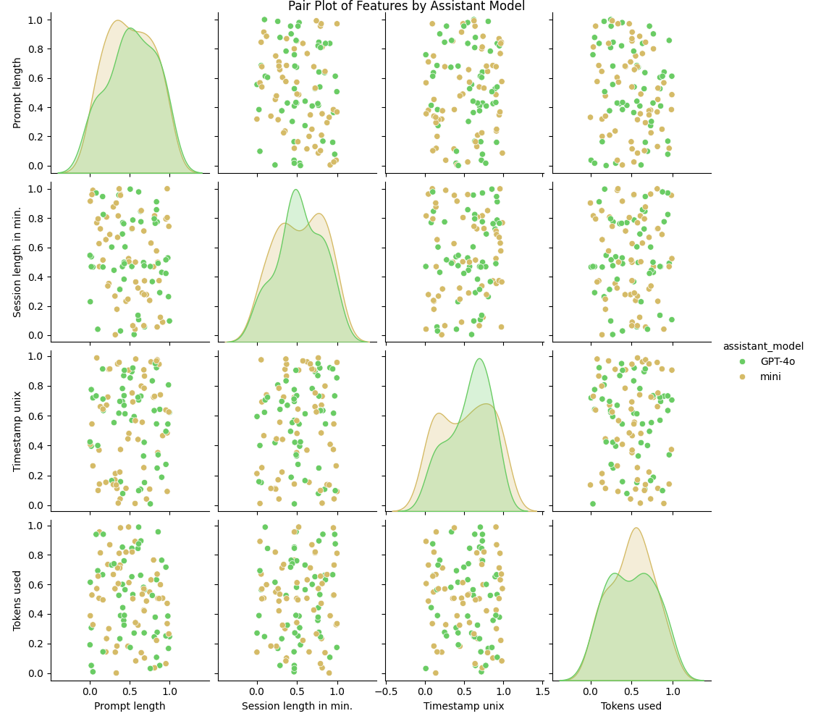
Pair Plots
…….

Slide 33
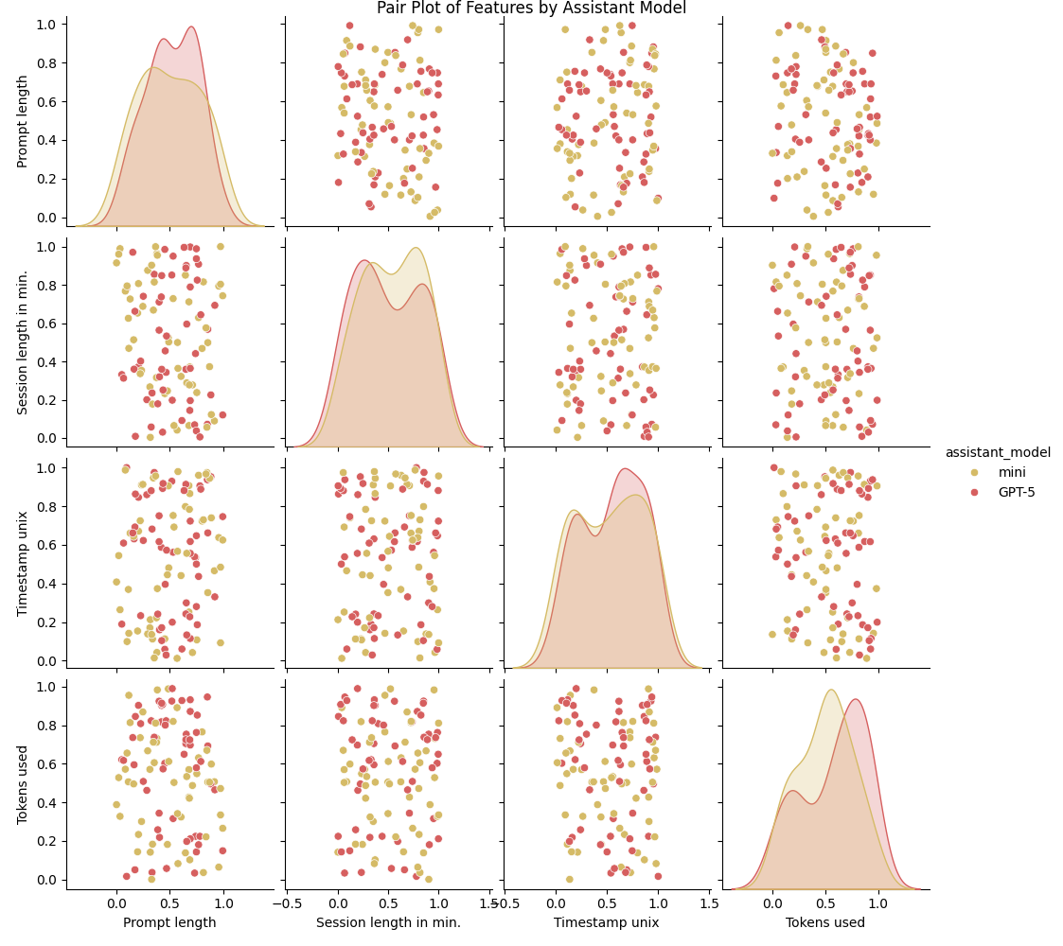
Pair Plots
……..

Slide 34
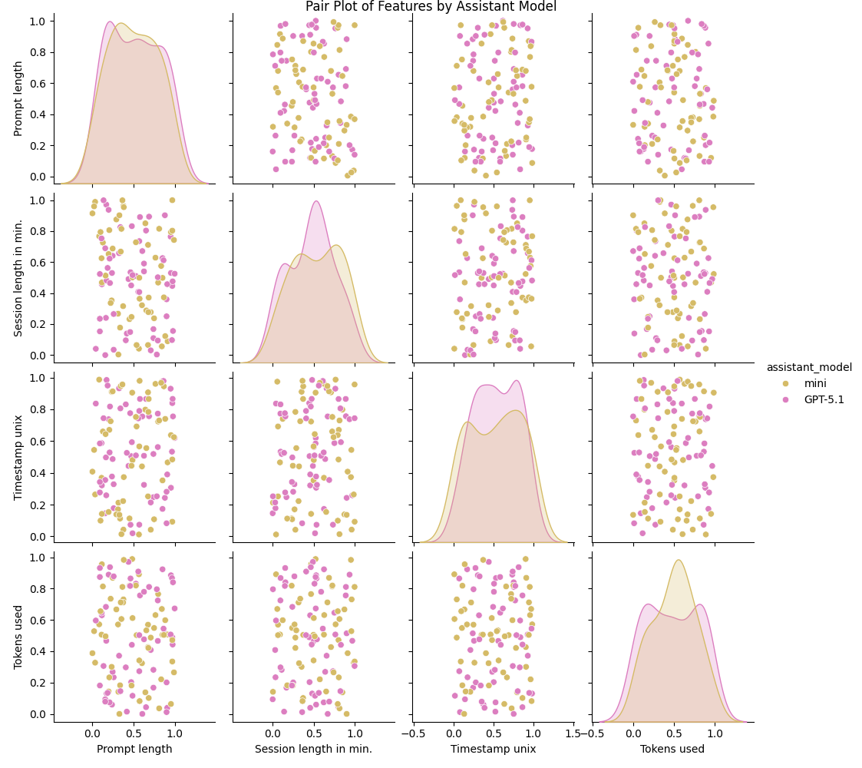
Pair Plots
………

Slide 35
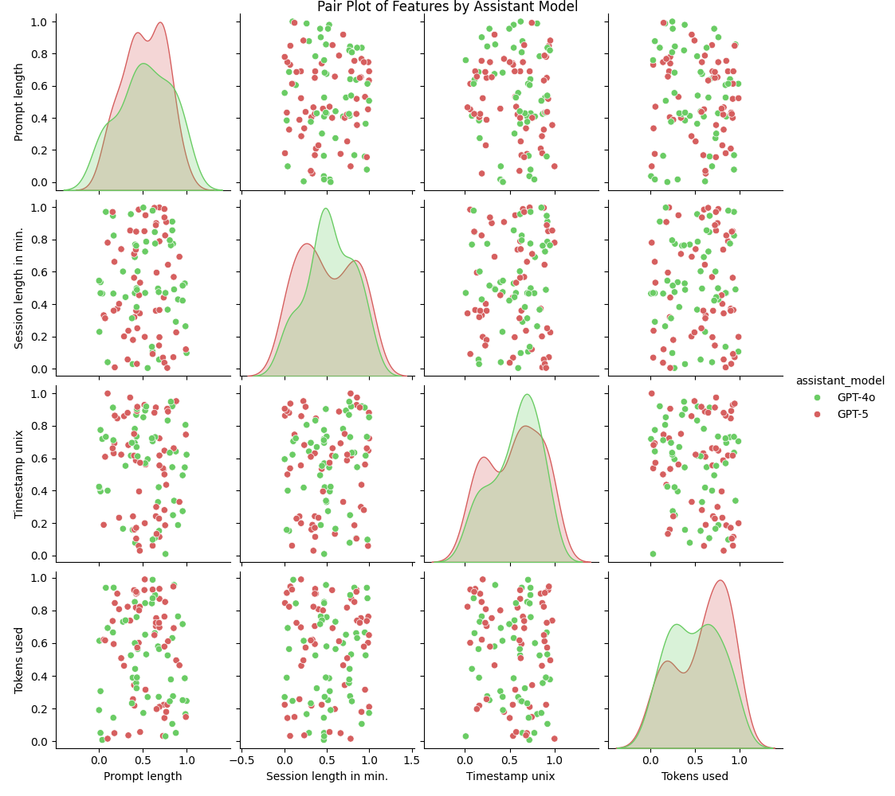
Pair Plots
……….

Slide 36
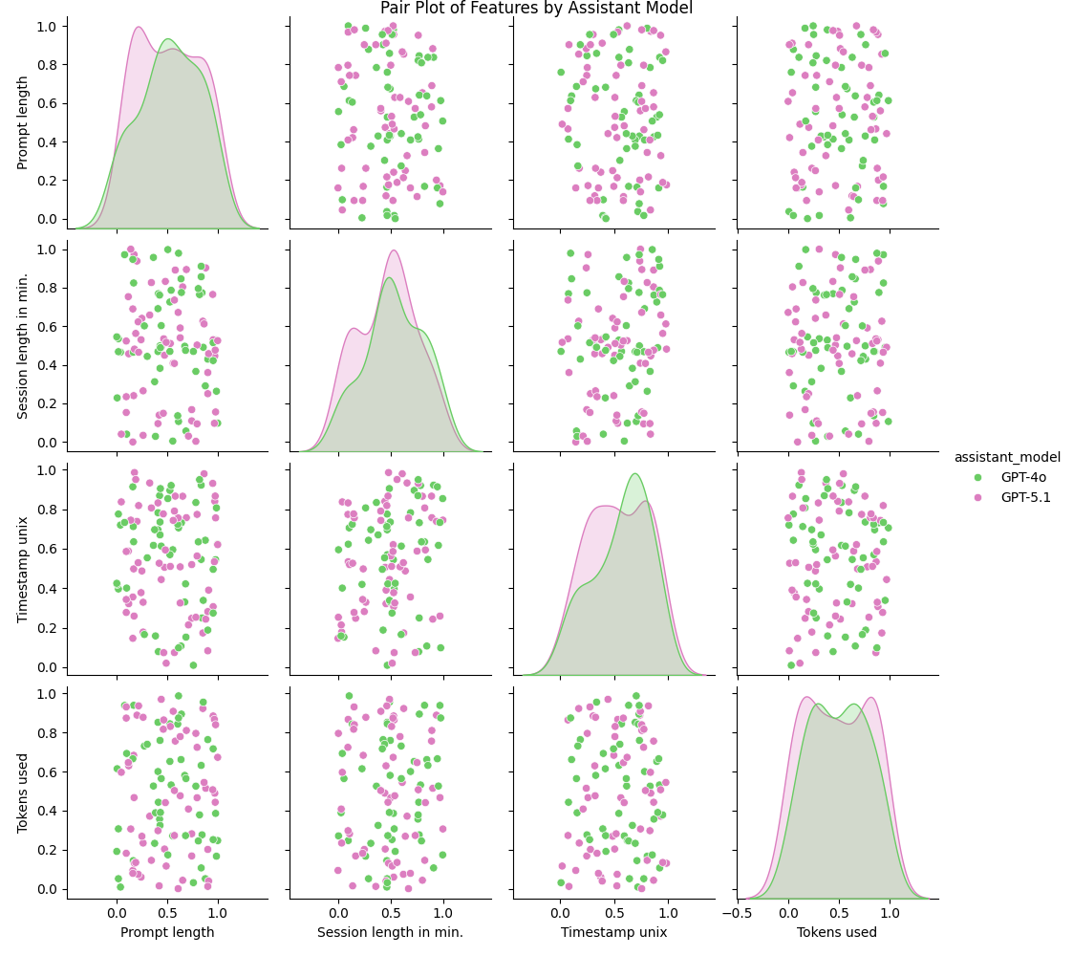
Pair Plots
………..

Slide 37
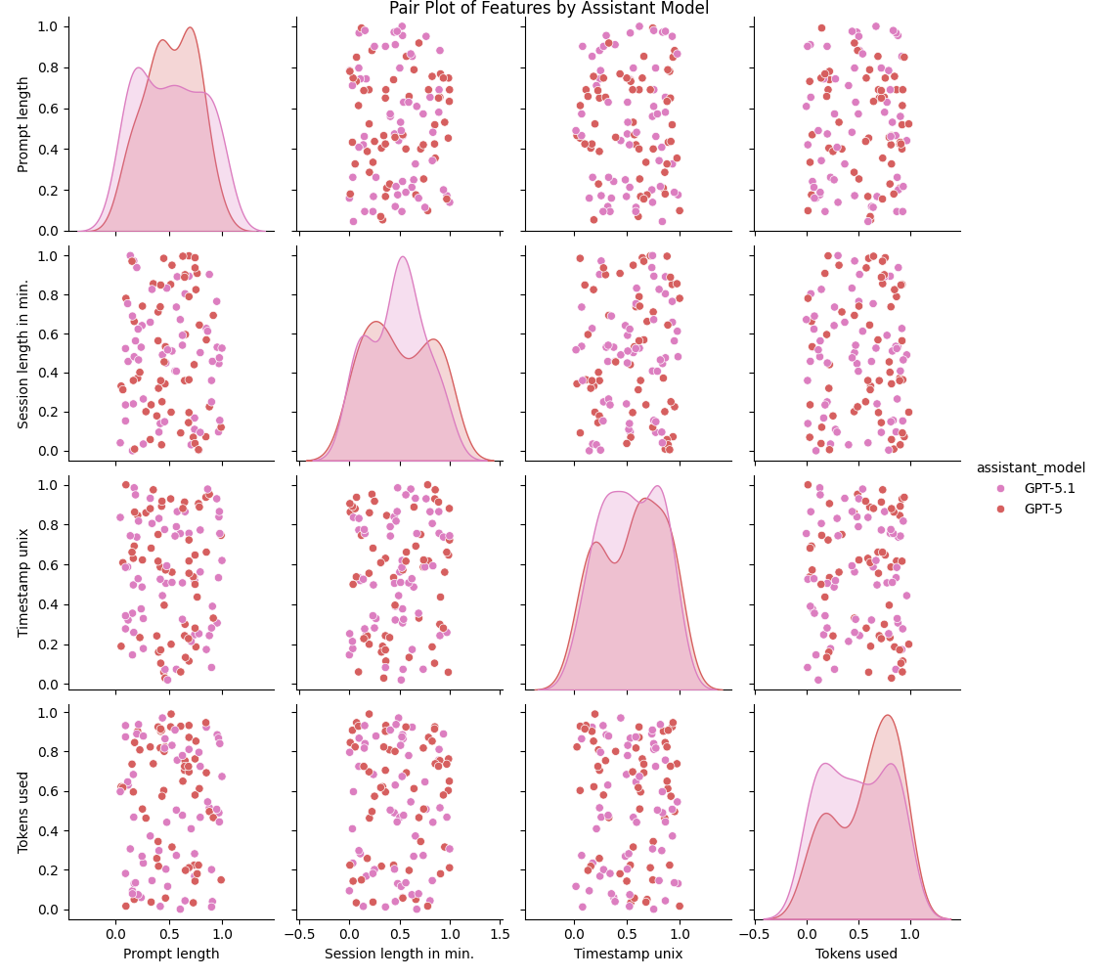
Pair Plots
…………
There are no clear Groupings.

Slide 38
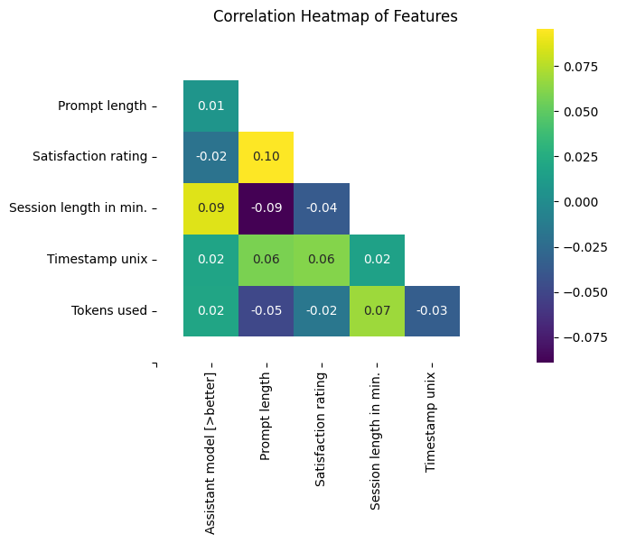
Correlation Analysis

Slide 39
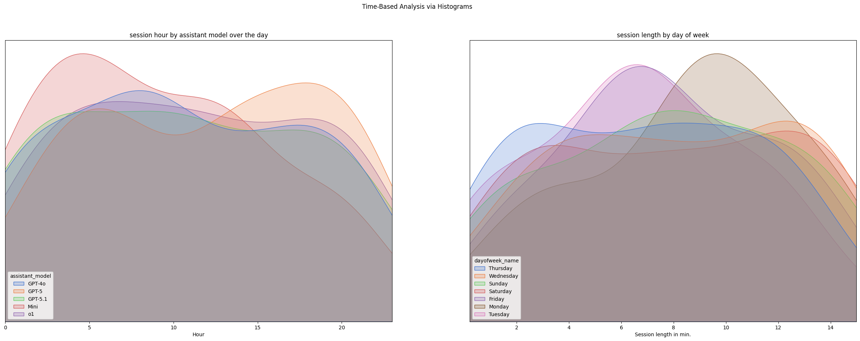
Time – Based Analysis
Notes:
Radial plot

Slide 40
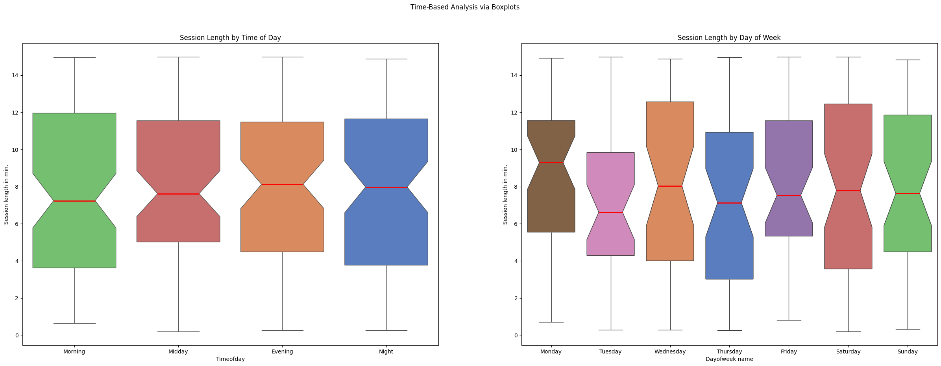
Time – Based Analysis

Slide 41
Additional insights
Analysis of the timeperiod of the database.
Analysis of the tokens used per minute per model
Analysis of the relation between Device and Satisfaction rating
Analysis of the correlation between weekday and time of day
Analysis of the Average session length per usage category.

Slide 42
Analysis of the time period of the database
We get that the timeperiod of this database is only 69 days.

Slide 43
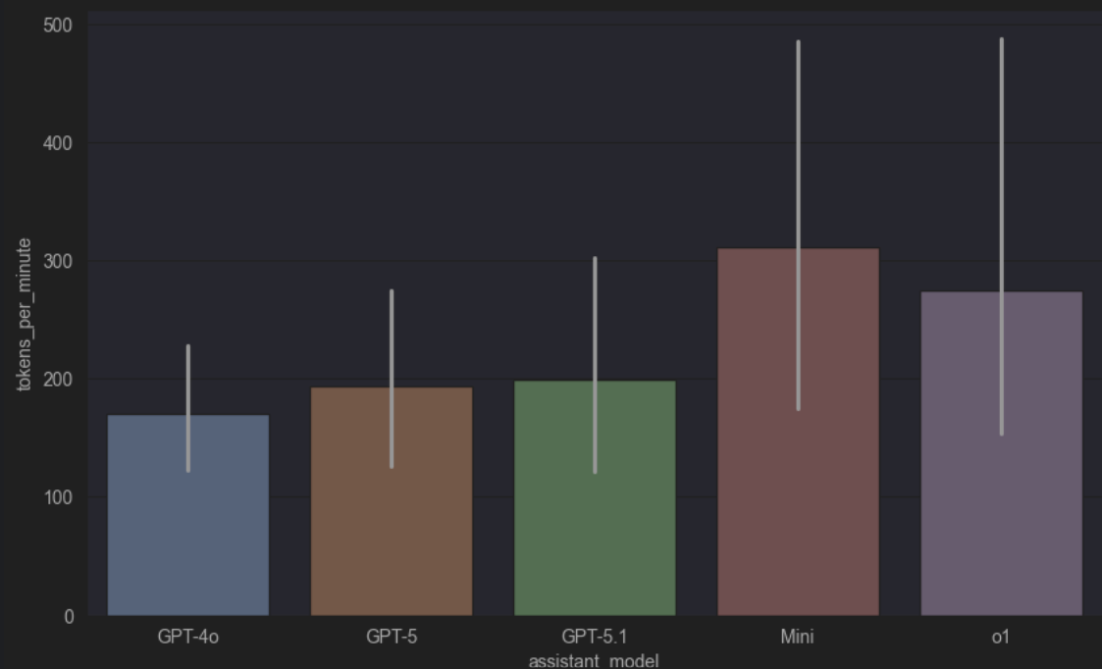
Analysis of the tokens used per minute per model

Slide 44
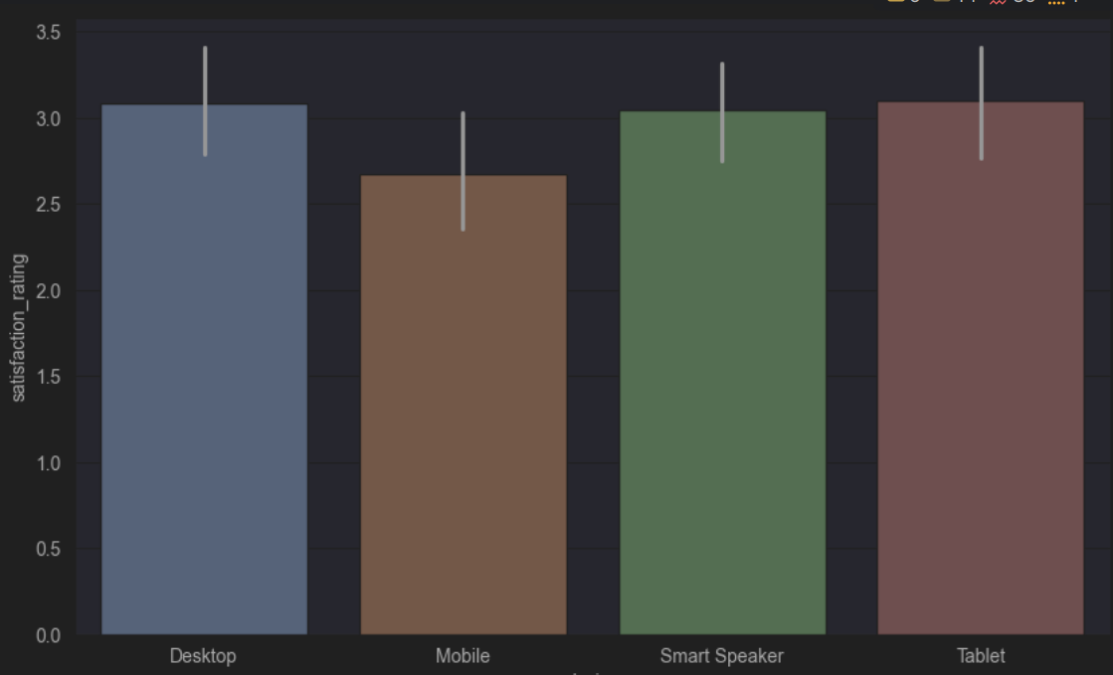
Analysis of the relation between Device and Satisfaction rating

Slide 45
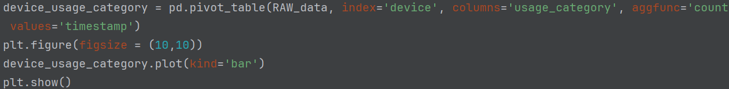
Analysis of the relation between Device and Usage category. Code

Slide 46
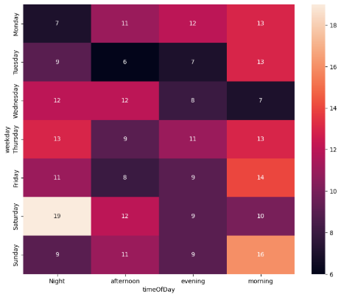
Analysis of the correlation between weekday and time of day
The heatmap shows AI assistant usage by day of the week and time of day. The number of sessions is the highest on Saturday night (19 sessions) and Sunday morning (16 sessions), while weekday afternoons, especially Tuesday and Wednesday, are less active.

Slide 47
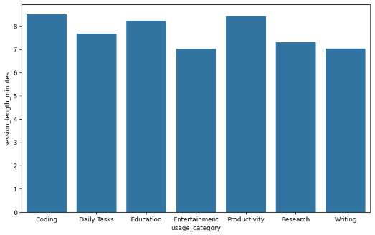
Analysis of the Average session length per usage category
In the result we can see that coding tasks have the longest average session duration, showing that they are more time-consuming and require longer interactions with AI assistants.

Slide 48
Summary
Number of Tasks completed: ^{(460 Lines of Code/Comments)}
Total of 27 tasks completed (22 mandatory and 5 additional tasks), each presented by the person responsible.
Challenges:
The dataset is small, artificially created and hard to draw conclusions from.
Surprising findings:
The use of smart speakers, especially for tasks like coding.
The dataset was synthetically generated. (some datasets are not marked as synthetic)
What we learned:
We learned how to use GitHub repositories.
Read the Kaggle page first (Fully, not just skimming)

Slide 49

Q&A

Slide 50

E n D

